Slide 1


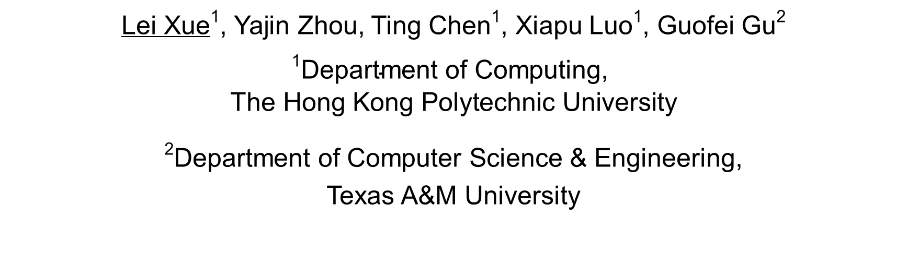
Malton: Towards On-Device Non-Invasive Mobile Malware Analysis for ART
Lei Xue¹, Yajin Zhou, Ting Chen¹, Xiapu Luo¹, Guofei Gu²
$$\begin{aligned}\text{1}\text{Department} \text{of} \text{Computing}\text{, } \\ \text{The} \text{Hong} \text{Kong} \text{Polytechnic} \text{University} \end{aligned}$$
²Department of Computer Science & Engineering,
Texas A&M University
Notes:
Good afternoon everyone, I am very honored to present our paper “Malton: Towards On-Device Non-Invasive Mobile Malware Analysis for ART”. This work is joined with Yajin Zhou, Ting Chen, Xiapu Luo, Le Yu from the Hong Kong Polytechnic University, and Guofei Gu from Texas A&M University.

Slide 2
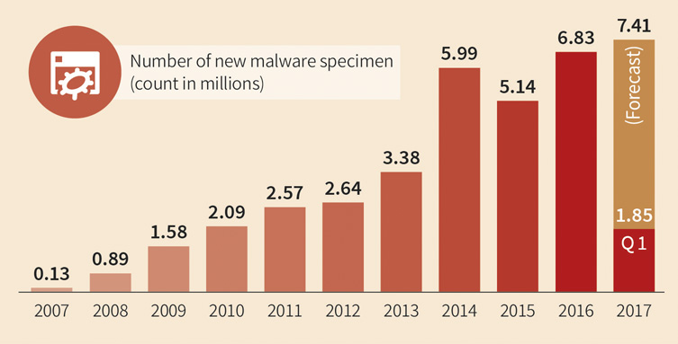
7.41 millions
In 2016, a malware per 4.6 sec
In Q1/2017, a malware per 4.2 sec
https://www.gdatasoftware.com/blog/2017/04/29666-malware-trends-2017
Notes:
This figure illustrates the trend of Android malware.
It is forecasted that the there will be more than 7 millions of Android malware by the end of 2017.
Also, we can find in 2016, there was a malware found every 4.6 seconds, while in the first quarter of 2017, a malware was found per 4.2 seconds.
So, malware analysis tools that can help security analysts efficiently analyze malware and quickly detect Android malware are in urgent need.

Slide 3
Existing Android Malware Analysis Tools
Focus on a specific layer
1
e.g., DroidBox (Android framework layer), DroidTrace (System layer)
Run in the emulator
2
e.g., DroidScope, Copperdroid (QEMU)
Modify the DVM or the compiler of ART
3
e.g., TaindDroid (DVM), TaintART, ARTist (dex2oat of ART)
Modify the target apps
4
e.g., Aurasium
Notes:
Various tools have been proposed to assistant Android malware analysis, most of the existing Android malware analysis tools are implemented through following methods.
First, they focus on monitoring the behaviors of Android malware in a specific layer. For example, DroidBox runs in Android framework layer, it tracks sensitive behaviors through hooking special Android framework methods. DroidTrace runs in Android system layer, it is implemented through injecting the target app by invoking function ptrace(), and then it monitors the sensitive behaviors of Android app through monitoring the invocations of system calls.
Second, some existing tools are implemented based on Android emulators, such as DroidScope and CopperDroid. Both tools conduct dynamic tracking using the instrumentation interfaces provided by Android emulator Qemu.
There are also some tools that are implemented through modifying the Android system or the compilers Android runtime. For example, TaintDroid is implemented based on the modifications of Android runtime DVM. TaintART and ARTist are implemented through modifying the compiling tool dex2oat of Android runtime ART, and then the additional taint propagation instructions are inserted into the apps when their Dalvik bytecode are compiled into native code by dex2oat.
Moreover, some tools are implemented through modifying the implementations of the target apps. Such as Aurasium. It attaches the target apps with user-level sandboxing and policy enforcement code through repackaging the apps.

Slide 4

1
Detect Android emulator
Mechanisms for evading detection
2
Anti Debugging
Malware
3
Obfuscation and packing
Malton
On-device and Non-invasive Analysis for ART
Notes:
At the sametime, Android malware start to adopt different mechanisms to evade detection and analysis through detecting the existence of the malware analysis tools.
The malware can detect its running environment to detect the existence of emulator-based analysis tools. If it finds it runs in an Android emulator, it will not release its malicious payloads or conduct sensitive behaviors. There are different methods that can be used to detect emulator, for example, the malware can get the hardware type of the Android system, if it is “goldfish”, then it runs in the emulator.
Second, malware can protect themselves from debugging. For example, some malware inject themselves through invoking function ptrace(), because a process can only be injected once. When the malware has been injected by itself, the debugging tools depend on ptrace cannot inject the target process. (Some malware also detect whether they are instrumented by the framework xpose through detecting the activity start intent, because when we use xpose to analysis an app, we need start the analyzed target app with special intent.)
In addition, malware can adopt obfuscation and packing serveries to protect themselves from being analyzed and repackaged. Note that, the packed apps could be not compiled into native code when they are installed into Android system with ART, hence the dynamic analysis tools depending compiler dex2oat do not adapt to these malware.
To resolve all these problems, we propose a novel dynamic analysis tool named Malton, which conducts on-device and non-invasive analysis for ART runtime.

Slide 5

Agenda
Motivating Example
The New Android Runtime (ART)
Malton
Evaluation
Conclusion
Notes:
I will introduce Malton following these five aspects.
First, I will use a motivating example to illustrate the major functions of malton.

Slide 6
Motivating Example
36 public void onReceiver(Context context, Intent intent){ 37 String body = smsMessage.getMessageBody(); 38 // Get the telephone of the sender 39 String sender = smsMessage.getOriginatingAddress(); 40 // Check if the SMS is sent form the controller 41 if(equals(sender, "6223**60")) { 42 procCMD(Interger.parseInt(body), body); 43 } 44 ... 45 }
26 public boolean equals(String s1, String s2) { 27 if(s1.count != s2.count) 28 return false; 29 if(s1.hashCode() != s2.hashCode()) 30 return false; 31 for(int i = 0; i < count; ++i) 32 if (s1.charAt(i) != s2.charAt(i)) 33 return false; 34 return true; 35 }
Handle received SMS
Check the source of SMS
11 private void procCMD(String cmd, String msg){ 12 if(cmd == “cm”) { 13 readSMS(); // Read SMS content 14 } else if(cmd == “cq”) { 15 readContact(); // Read Contact content 16 } else if(cmd == “qf”) { 17 readIMSI(); // Read device IMSI information 18 } else if(cmd == “df”) { 19 rebootDevice(); // Reboot the device 20 } else if(cmd == “dy”) { 21 parseMSG(msg); // Parse msg in native code 22 } else { // The command is unrconginized. 23 reply("Unknown command!"); 24 } 25 }
1 public static native void readContact(); 2 public static native void parseMSG(String msg); 3 private void readIMSI(){ 4 TelephonyManager telephonyManager = 5 (TelephonyManager) getSystemService( 6 Context.TELEPHONY_SERVICE); 7 String imsi = telephonyManager.getSubscriberId(); 8 // Send back data through SMTP protocol 9 smtpReply(imis); 10 }
Take actions according to commands
Parse commands in SMS
Notes:
When this malware starts, it first registers a SMS handler to handle the received SMS.
When a SMS arrives, it gets the source telephone number of the SMS, and then checks whether this SMS is from the remote controller. Note that, it compares the hash values of the telephone numbers instead of comparing the strings of telephone numbers.
If this SMS is from the remote controller, it parses the remote command in the content of the SMS, and then invokes method “procCMD()” to process the remote command.
In this sample, there are five different commands that can be processed, that are read SMS, read Contact, read IMSI, reboot device and default action. Note that, the actions of these commands implemented by both Java method and JNI methods.

Slide 7

Challenges
11 private void procCMD(int cmd, String msg){ 12 if(cmd == “cm”) { 13 readSMS(); // Read SMS content 14 } else if(cmd == “cq”) { 15 readContact(); // Read Contact content 16 } else if(cmd == “qf”) { 17 readIMSI(); // Read device IMSI information 18 } else if(cmd == “df”) { 19 rebootDevice(); // Reboot the device 20 } else if(cmd == “dy”) { 21 parseMSG(msg); // Parse msg in native code 22 } else { // The command is unrconginized. 23 reply("Unknown command!"); 24 } 25 }
1 public static native void readContact(); 2 public static native void parseMSG(String msg); 3 private void readIMSI(){ 4 TelephonyManager telephonyManager = 5 (TelephonyManager) getSystemService( 6 Context.TELEPHONY_SERVICE); 7 String imsi = telephonyManager.getSubscriberId(); 8 // Send back data through SMTP protocol 9 smtpReply(imis); 10 }
Take actions according to commands
Identify the cross-layer
information flow
Parse commands in SMS
Expose all malicious payloads triggered
by various commands efficiently
26 public boolean equals(String s1, String s2) { 27 if(s1.count != s2.count) 28 return false; 29 if(s1.hashCode() != s2.hashCode()) 30 return false; 31 for(int i = 0; i < count; ++i) 32 if (s1.charAt(i) != s2.charAt(i)) 33 return false; 34 return true; 35 }
Check the source of SMS
Force app to execute a certain path if
the desired input cannot be generated.
Notes:
During analysis of this malware, as the malicious actions decided by the remote commands refer to both Java methods and Native methods, malton should be able to monitor the malicious behaviors in multiple layers and identify cross-layer information flow.
Moreover, different malicious actions can be triggered by different commands for this malware, hence malton should be able to expose all the malicious actions efficiently.
We employ concolic execution to explore new execution paths, but for this malware, the constraint refer to the telephone number include hash calculation, so it is too complex to be resolved to generate new input for exploring new execution path. Thus, malton should be able to force app execute a certain path when the desired input cannot be generated.

Slide 8
Agenda
Motivating Example
The New Android Runtime (ART)
Malton
Evaluation
Conclusion
Notes:
Before introducing the details about malton, I will give a short introduction about the new android runtime ART.

Slide 9
Android Runtime
Dalvik
bytecode
DEX
DEX
Dalvik
bytecode
Just in Time
dexopt
dex2oat
Ahead of Time
Optimized
bytecode
Native code
and bytecode
ODEX
OAT
libdvm.so
Dalvik bytecode
libart.so
Either bytecode or native code
Runtime
DVM
ART
Notes:
This figure illustrates the Android runtime DVM, which is adopted by Android system before Android 5.0. For an Android app, all its Dalvik bytecode are stored in the Dex files. When the app is installed into an Android system running DVM, the Dex file will be optimized to a Odex file by the tool dexopt. During the running of the app, the Dalvik bytecode will be interpreted by DVM.
ART become the default Android runtime from Android system 5.0. When an app is installed into the Android system running ART, the Dalvik bytecode in Dex file are compiled into native code by dex2oat, then both original Dalvik bytecode and the native code are stored in the OAT files. During the running of the app, the native code will execute in ART runtime directly. For the methods that are not compiled into native code, the ART runtime interprets their Dalvik bytecode.

Slide 10
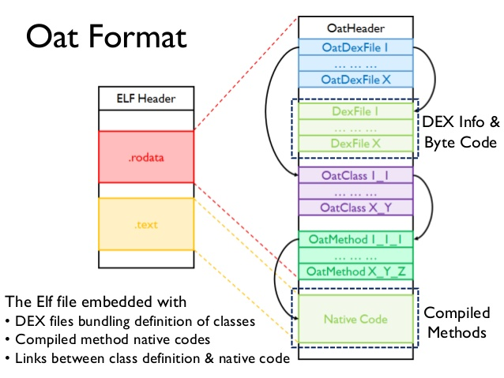
The OAT File
Parse OAT files
Get the code regions of compiled methods
Track methods according to the execution of the compiled code
Notes:
Oat file is a special ELF file. It is embedded with the original Dex file and the native code of the compiled methods.
Thus, we can parse the OAT files following their formats to get the native code regions of all the compiled methods, and then we can dynamically track the method invocations according the execution of the native code.

Slide 11
Agenda
Motivating Example
The New Android Runtime (ART)
Malton
Evaluation
Conclusion
Notes:
Next, I will introduce the details about malton.

Slide 12



Malton
Comprehensive
Behaviors
Running on a real device;
Conducting cross-layer monitoring and information flow tracking;
Doesn’t need to modify the app.
Notes:
Given an Android app, malton will run it on a real device with ART runtime, and conduct cross-layer monitoring and information flow tracking. As malton is implemented based on the dynamic instrumentation framework Valgrind, it does not need to modify the app.
When an app run on the device, malton conducts three major types of analysis on it, it monitors the behaviors of the app in multiple layers and tracks its cross-layer information leakage flow. Malton also conducts path exploration on the specified code regions.
After each running, an trace log will be generated, it contains the information about the invoked Android framework methods, runtime functions, system library functions and system calls. In addition, the information about the taint propagations is also stored in the trace log.
Thus, based on the analysis of the trace log, malton can provide the comprehensive behaviors of the target app to users, including the execution paths in multiple layers, cross-layer data leakage flows and the other implementation features.

Slide 13
The Design of Malton
Android Framework
Android Runtime
System Libraries
Kernel
Notes:
This figure illustrates the multiple layer architecture of Android system, the Android framework is implemented by Java code and all its implementation is in the file boot.oat. Note that, both App’s custom Java methods and the Android framework methods work in Android framework layer.
In addition, both the Android runtime and system libraries are implemented by native code, and we do not consider Android kernel behaviors in this paper.
Consequently, we design Malton according to the architecture of Android system, and it is comprised by four major components which run in four layers, Android framework layer, Android runtime layer, android system layer and Instruction layer. Because Malton is implemented based on Valgrind. It translates all the native instructions into IR statements for instrumentation, so Malton also conducts dynamic tracking in the instruction layer.

Slide 14

Android Framework Layer
OAT File Parser
Get the beginning addresses of the compiled methods.
Get the types of the methods’ parameters and return values.
Java Method Tracker
Get information about the invoked methods with their parameters.
Get information about the returned methods with results.
Java Object Parser
Get the content stored in Java class instance. (i.e., result of TelephonyManager.getDeviceId() )
StringObject
object_.klass_
object_.monitor_
…..
value: “6534900622308366”
Notes:
In Android framework layer, there are three major modules, which are designed with different purposes. Oat file parser is used to parse the OAT files. With it, we can get the beginning addresses of all the compiled methods and the information about the methods’ parameters and results.
Java method tracker tracks the invocations and returns of the compiled java methods. It tracks method invocations through comparing the target address of each Jump instruction with the beginning addresses of the compiled methods, if the target address equals the beginning address of a method, then the method will be invoked, meanwhile, Malton gets the return address of this method from the register lr, and pushes it into a method call stack.
Moreover, Malton tracks the method returns through comparing the target address of the Jump instruction with the return address at the top of the method call stack, if they are same, the last invoked method returns.
As in ART runtime, the class instance is represented by java objects, we use java object parser to get the real content of the class instance through parsing the Java object.
Take the result of TelephonyManager.getDeviceId() as an example, this method is used to read the device ID, and the result is stored in a Java string which is represented by a Java string object in ART runtime. When this method returns, we can get the address of the Java string object from register r0 and then get the concrete value of the result through parsing the Java string object. (Thus if this method is specified as taint source, we can attach the memory storing the concrete value of the result with taint tag. )

Slide 15

Android Runtime Layer
Native Code Loading
Track the dynamically loaded native code
Java Code Loading
Track the dynamically loaded Java code
JNI Invocation
Track the native methods invoked by Java code
JNI Reflection
Track the Java methods invoked by native code
Java Reflection
Track the Java methods invoked through Java reflection
Malton can be easily extended to support the tracking of new behaviors.
Notes:
In Android runtime layer, there are five modules provided to track different behaviors.
Because malware could dynamically load its malicious native code to the memory, malton tracks the dynamically loaded native code through monitor the dynamic native code loading behaviors.
Because malware could also dynamically load malicious Java code into runtime, malton tracks the dynamically loaded Java code through monitoring the dynamic Java code loading behaviors.
Since the app’s Java code can invoke its native code through JNI interfaces, Malton tracks the native methods invoked from Android framework layer throng monitoring the JNI invocations.
Except the normal method invocation, the Java code can also be invoked by native code and Java code through JNI reflection and Java reflection respectively, hence malton also tracks these invoked Java methods through monitoring the JNI reflections and Java reflections.
Node that, malton monitors all these behaviors through tracking the invocations of the corresponding methods, so malton can be easily extended to support the tracking of new behaviors.

Slide 16

System Layer
Network Operations
Monitor information leaked through network.
Monitor the received remote commands.
File Operations
Monitor the access of personal files in storage.
Monitor dynamically released and deleted data.
Memory Operations
Monitor dynamically memory modification .
Process Operations
Monitor protection behaviors (e.g., anti-emulator and anti-debugging)
Notes:
In system layer, Malton tracks four types of behaviors with four modules.
Through tracking the network operations, Malton can monitor the information leaked through network and the remote commands received from network.
Through tracking the file operations, Malton can monitor the access of the personal files in storage. Because, malware can also dynamically release malicious data into storage and then delete it after using, malton can also monitor these behaviors.
Since malware can dynamically modify its malicious payloads in the memory, malton detect such behaviors through tracking the memory operations.
By tracking the process operations, malton can monitor the malware’s protection behaviors, for example, malare can anti debugging through injecting its own process by itself, and anti-emulator through detecting the existence of special processes.

Slide 17
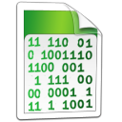
Instruction Layer
Taint Propagation
Track the information leakage flow.
In-memory Concolic Execution
Explore more execution paths.
Direct Execution
Explore execution path, of which no input is generated.
Notes:
In Instruction layer, malton conducts three major tasks with different purposes.
It tracks the information leakage flow through taint propagation, and it explore the execution paths of specified code regions through in-memory concolic execution.
In addition, during concolic execution, if the new input cannot be generated, malton will explore the specific execution paths through direct execution.
Next, I introduce the details of these three tasks.

Slide 18
Taint Propagation
We propagate taint tags according to the logics of 9 IR statements and 11 IR expressions.
……
t12 = Load(0xabcd1234)
Put(8) = t12
……
……
Taint(t12) = Taint(0xabcd1234)
Taint(8) = Taint(t12)
……
Execution
Taint propagations
Notes:
Malton conducts taint propagation following the logics of the IR statements and IR expressions, and there 9 IR statements and 11 IR expressions that are related to taint propagations, for details, you can refer to our paper.
I will use an example to illustrate how taint tags are propagated. There are two IR statements in this example, in the first IR statement, the Load expression is used to load a value from the address 0xabcd1234, and then the loaded value will be stored in the temporary t12. When the second IR statement is executed, the concrete value of temporary t12 will be put into offset 8 of the ThreadState. ThreadState is used as guest registers in Valgrind.
Therefore, when the first IR statement is executed, Malton gets the taint tag of source memory 0xabcd1234, and then propagates the taint tag to the temporary t12.
When the second IR statement is executed, Malton propagates the taint tag of temporary t12 to the offset 8 of the THreadState.
Note that, we employ shadow temporaries, shadow memory and shadow threadstate to store the taint tags of the temporary, memory and threadstate respectively.

Slide 19
Path Exploration
Inputs:
CMD = “cq”
CMD = “qf”
CMD = “df”
…
Constraints
CMD
CMD
Z3
Resolver
CMD
APP
CMD = “cq”
Inputs
cq ？
cq
1 ？
CMD = “qf”
Desktop
Phone
Concolic Execution with Offloading Mechanism
qf ？
qf
CMD = “df”
df ？
df
Constraints:
CMD == “cq” ?
CMD == “qf” ?
CMD == ”df”?
…
3 ？
Notes:
We explore execution paths through concolic execution.
Since the mobile device has limited resources and concolic execution requires considerable computational resources, we design a offloading mechanism to improve the efficiency of path exploration.
We run the target app with concolic execution in the mobile device, and then output the constraints to the desktop. On the desktop, we run the constraint resolver Z3 to resolve the constraints and generate new inputs, and then the new inputs will be pushed into the mobile device for exploring new execution paths.
Now we use an example how the execution paths are explored. In this example, there are three different branches, and all of them depend the input CMD.
After the first running, three constraints are generated, then we can generate three new inputs through resolving the constraints. When execute the app with the three new inputs respectively, each new input can explore a new execution path.

Slide 20
Path Exploration
In-memory optimization：
Run specified code regions iteratively with different inputs
Direct Execution
Force an app execute a path without input
11 private void procCMD(int cmd, String msg){ 12 if(cmd == “cm”) { 13 readSMS(); // Read SMS content 14 } else if(cmd == “cq”) { 15 readContact(); // Read Contact content 16 } else if(cmd == “qf”) { 17 readIMSI(); // Read device IMSI information 18 } else if(cmd == “df”) { 19 rebootDevice(); // Reboot the device 20 } else if(cmd == “dy”) { 21 parseMSG(msg); // Parse msg in native code 22 } else { // The command is unrconginized. 23 reply("Unknown command!"); 24 } 25 }
26 public boolean equals(String s1, String s2) { 27 if(s1.count != s2.count) 28 return false; 29 if(s1.hashCode() != s2.hashCode()) 30 return false; 31 for(int i = 0; i < count; ++i) 32 if (s1.charAt(i) != s2.charAt(i)) 33 return false; 34 return true; 35 }
cmd=“cm”
cmd=“cq”
……
IR: if(t) Return
Set t = False
Notes:
Sometimes, the interested execution paths are just related to a specific code region, if we run the whole app iteratively, it can bring heavy overhead. We provide in-memory optimization to improve the efficiency of path exploration. With in-memory optimization, we can specify malton to only run the specified code region iteratively. More precisely, at the end of the code region, we will modify the return address to the beginning address of the code region, and then malon will run the specified code region with new input to explore new execution path. For example, we first run the code region with input “cm” to explore the path of method readSMS() and then run the code region with input “cq” to explore another execution path. We will iteratively run this code region with different inputs until all the execution paths in this code region are explored.
For some complex constraints, it cannot be resolved by constraint resolver, hence no new input will be generated to explore the new path. For this status, we can force the app execute a path without required input. Such as this example, the constraint of the hash calculation can not resolved, and we can not let the app execute forward with new input. Since the condition of conditional branch is stored in a temporary of Exit IR statement, we change the concrete value the temporary to true to let the app execute forward.

Slide 21
Agenda
Motivating Example
The New Android Runtime (ART)
Malton
Evaluation
Conclusion
Notes:
We have designed different experiments to evaluate Malton, because the time limitation, I only introduce some evaluation results here.

Slide 22
Discovering Sensitive Operations
Behavior | CopperDroid | DroidBox | Malton
Personal Info | 435 (85.0%) | 135 (26.4%) | 511 (99.8%)
Network access | 351 (68.5%) | 211 (41.2%) | 445 (86.9%)
File access | 438 (85.5%) | 509 (99.4%) | 512 (100%)
Phone call | 52 (10.1%) | 1 (0.2%) | 59 (11.5%)
Send SMS | 26 (5.1%) | 15 (2.9%) | 28 (5.5%)
Java code loading | NA | 509 (99.4%) | 512 (100%)
Anti-debugging | 4 (0.8%) | NA | 4 (0.8%)
Native code loading | NA | NA | 160 (31.2%)
512 samples and results of CopperDroid are downloaded from its web servers.
Result: Malton can capture more sensitive behaviors thanks to its on-device and cross-layer inspection.
Notes:
In this experiment, we compare Malton with CooperDroid and DroidBox on discovering sensitive operations using 512 real malware samples. For cooperDroid, we get the analysis results of these malware from its web sites. For DroidBox and Malton, we run the malware with both tools to generate analysis reports. Then, we compare the analysis results on eight different types of behaviors, and the comparing results are shown in this table. From this table, we can find for each type of behavior, Malton has detected more samples than the other two tools. Take the Phone Call behavior as an example, CooperDroid finds 52 samples have this behavior, DroidBox detects 1 malware has this behavior, and Malton discovers 59 malware perform this behavior.
Therefore, we can find Malton can capture more sensitive behaviors thanks to its on-device and cross-layer inspection.

Slide 23
Path Exploration
Command | Detected behavior | No. of executed blocks
“cq” | Read information SMS contents, contacts, device model and system version, then send to 292019159c@fcvh77f.com with password “aAaccvv11” through SMTP protocol. | 32k/20443k
“qf” | Send SMS to all contacts with no SMS content. | 7k/20537k
“df” | Send SMS to specified number, and both the number and content are specified by the command SMS. | 5k/22970k
“zy” | Set unconditional call forwarding through making call to “**21* targetNum%23”. | 8k/22848k
“by” | Set call forwarding when the phone is busy through making call to “%23%23targetNum%23”. | 15k/20639k
“ld”, “fd”, “dh”, “cz”, “fx”, “sx”, “dc”, “bc” | Modify the its configuration file zzxx.xml. | 5k-18k/20403k-20452k
Others | Tell the controller the command format is error by replying an SMS. | 15k/20443k
With in-memory optimization: 5k
Without in-memory optimization: 22,970k
Result: Malton can explore paths effectively and efficiently because of the in-memory optimized concolic execution.
Notes:
In this experiment, we evaluate the path exploration performance of Malton. This malare performs different sensitive behaviors according to the remote commands in SMS, hence we specify code region of processing the remote commands as the target code region, and then run Malton the explore the paths depends on the remote commands. The exploration results are shown in the this table. The first column represents the remote commands, and the second column represents the corresponding behaviors. From the result, we can find the behaviors related to all the 14 commands have been successfully explored.
In addition, we also evaluate the in-memory optimization through exploring each execution path with and without in-memory optimization, and the results are shown in the third column.
Take the command ‘df’ as an example, when we explore this path with in-memory optimization, only 5k IR blocks need to execute. But when we run the whole app without in-memory optimization to explore this path, there are 22970 IR blocks executed.

Slide 24
Agenda
Motivating Example
The New Android Runtime
Malton
Evaluation
Conclusion
Notes:
Next, we will make a short conclusion of our work.

Slide 25
1
Propose and develop Malton, a novel on-device non-invasive analysis tool for ART.
2
Malton can provide a comprehensive view of the Android malware behaviors through multi-layer tracking and path exploration.
3
In future, we will automate the in-memory optimization and the recovery from crashes during direct execution.
Notes:
We propose and develop a novel malware analysis tool malton, which conducts on-device and non-invasive analysis on ART runtime.
Malton can provide a comprehensive view of the Android malware behaviors through multi-layer tracking and path exploration.
In addition, we will automate the in-memory optimization and the recovery from crashes during direct execution in future.

Slide 26


Slide 27
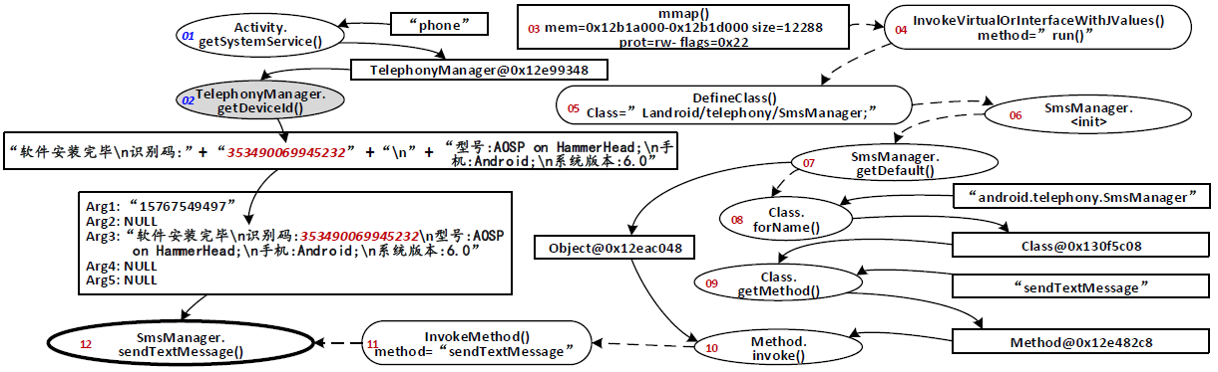
Inspecting Sophisticated Malware
Result: Malton can help the analyst capture the comprehensive information leakage flow and the stealthy behaviors through reflection.

Slide 28
Instruction Layer: Path Exploration
Purpose: Increase code coverage
Concolic Execution: Offloading Mechanism
Run apps on Android devices with symbolic execution
Solve constraints on PC through Z3
Concolic Execution: In-memory Optimization
Run specified code regions iteratively with different inputs
Direct Execution
Force an app execute a special path when no input is resolved

Slide 29
Example of Parsing String Result
The example to parse the result of TelephonyManager.getDeviceId()
StringObject
object_.klass_
object_.monitor_
count_
hash_code_
value:
“6534900622308366”
ClassObject
object_.klass_
object_.monitor_
……
name_(“java.lang.String”)
.…..
The real data of
Object instance
Instance of Java class
“java.lang.String”
(StringObject)
Instance of ClassObject
containing the object type
information

Slide 30
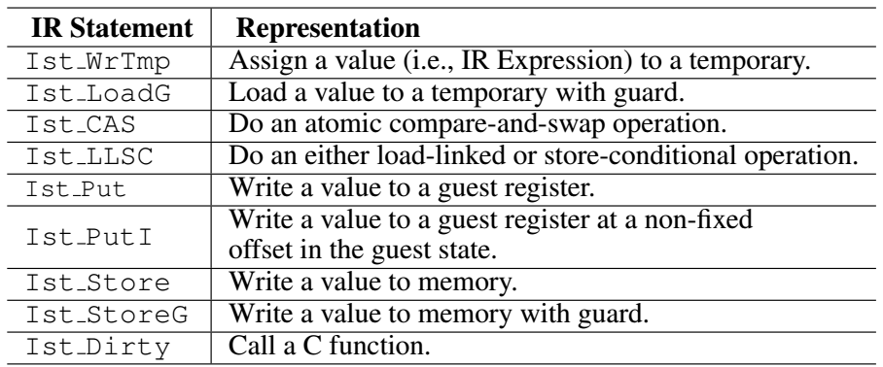
Instruction Layer: Taint Propagation
The taint propagation related IR statements

Slide 31
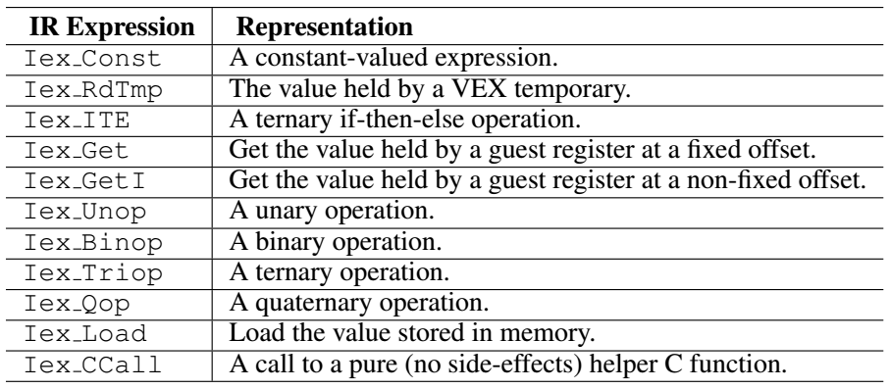
Instruction Layer: Taint Propagation
The taint propagation related IR expressions
t1 = Load(0xa22c3345)

